Slide 1
Offline Signature Verification Using Artificial Neural Network
Megha Purohit
Pallavi Agarkar
Priyanka Cheke
Sandhya Shiva Sankaran
Saranya Gopinath
Suhasini Hulikal

Slide 2
Motivation
Wide number of applications - financial areas like banks, checks and legal documents are verified on the basis of account number and signature of the account holder.
Offline Signature Verification is still an open research problem

Slide 3
Introduction
Signatures are a widely used form of biometric that are related to human characteristics.
The fact that a person’s signature is extensively used as a means of personal identification and verification emphasizes the need for an automatic signature verification
Types of signature verification:
Online Verification Approach: Also known as dynamic approach where signature is captured during the writing process.
Offline Verification Approach: Known as static approach where signature is taken once the writing process is over and only static image is available

Slide 4
Why Offline Signature Verification?
Offline signature verification is more challenging compared to online signature verification.
On-line – It uses an electronic pressure sensitive tablet to extract a signature and takes dynamic information like pen pressure , pen position data (x and y positions) of points while writing a signature.
Off-line – It is a static approach that uses less electronic control and the signature images are captured by a scanner or camera. The features used for offline signature verification are straightforward & are invariant.

Slide 5
Data Set
Taken from SIGCOMP 2011 competition
Link: http://www.iapr-tc11.org/mediawiki/index.php/ICDAR_2011_Signature_Verification_Competition_(SigComp2011)
The data set consists of 200 images of 10 persons

Slide 6
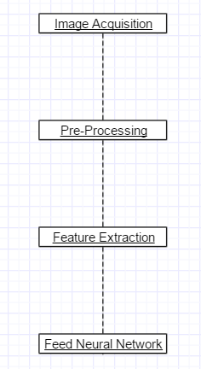
Methodology

Slide 7
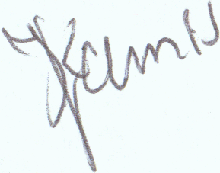
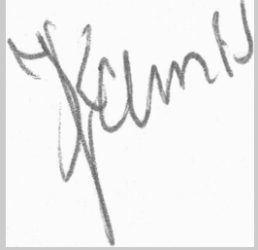
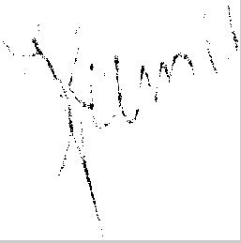
Pre Processing:
Pre - Processing improves the quality of the image and this helps in reducing a considerable amount of time for performing feature extraction
Steps involved:
Image resizing
Converting image to gray scale
Fig.1 Signature image after resizing Fig.2 Signature after gray scale
Converting image to binary
Thinning
Auto Cropping Fig.3 Signature after thinning

Slide 8
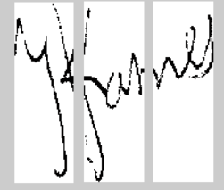
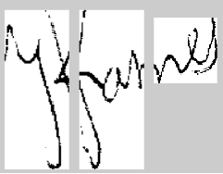
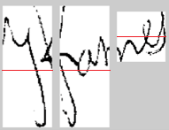
Feature Extraction
Maximum Black Pixels: Captures maximum number of black pixels in both rows(horizontal) and columns(vertical), (2 Features)
Center of mass: Segmenting the image into two equal parts and center of mass is calculated for each of them. (1 Feature)
Normalized Area: Normalized Area = Area of signature / Area of cropped image (1 Feature)
Aspect Ratio: Aspect Ratio = Width / height (auto cropped image) (1 Feature)
Tri-Surface: Image is split into 3 equal parts and Normalized area for each is captured
(3 Features)
Fig.4 Tri-Surface
Six-Fold: Tri-Surface split images are cropped and each part is split into two equal halves using center of mass.
Area of each of the 6 divisions are found (6 Features) Fig. 5 Six-Fold
Transition feature: Traversing in all 4 directions to calculate ratio for each transition from
0 to 1 and from 1 to 0 and total of 1 to 0 and 0 to 1 transitions

Slide 9
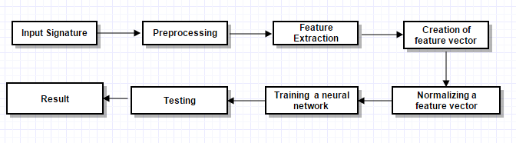
Training Neural Network
The network was trained using back propagation algorithm.
It is trained with genuine and forged signature.

Slide 10
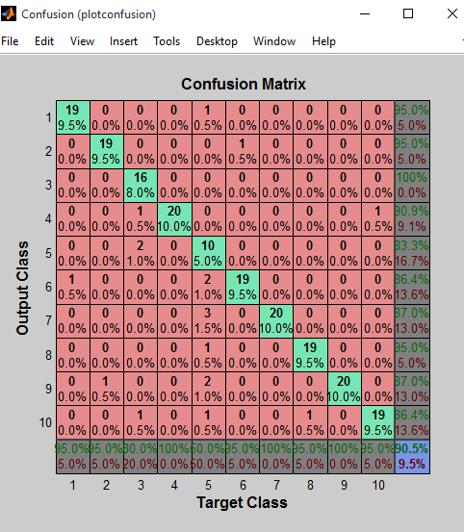
Results
Confusion Matrix for NN

Slide 11
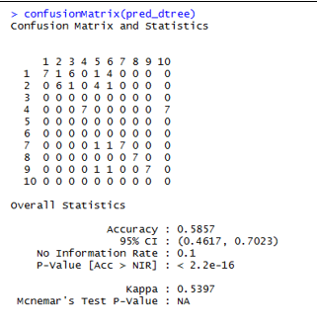
Results Contd…
Confusion Matrix of Decision Tree

Slide 12
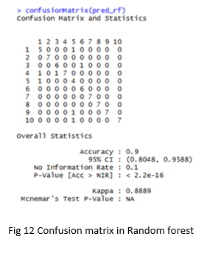
Results Contd…
Confusion Matrix of Random Forest

Slide 13
Tools and models used for offline signature verification:
Model | Tool
Neural Network | Matlab
Decision Tree | R
Random Forest | R

Slide 14
Results Comparison
MODEL | ACCURACY
Neural Network | 90.5%
Decision Tree | 58.6%
Random Forest | 90%

Slide 15
Conclusion
Neural network was able to classify between genuine and forged signatures.
Performance of NN, Decision Tree and Random Forest are analyzed and captured.

Slide 16
Future Scope
Providing a more robots system .
Handling invalid images – Classifying non-signature inputs like a random image, for e.g., image of an apple, etc.

Slide 17
Questions??

